Slide 1
Introduction of AUTOSAR
R & D
Date : 07/06/2023

Slide 2
AUTOSAR Fundamentals:
AUTOSAR stand for Automatic Open System Architecture
The AUTOSAR development partnership was founded in 2003 with the goal of establishing an open standard for electrical/Electronic architecture in the automotive industry.
“Cooperate on standards, compete on implementation”
Releases : Release Ver2.0 ~ Ver4.X (4.4 - 2018)
AUTOSAR Classic Platform &
AUTOSAR Adaptive Platform

Slide 3
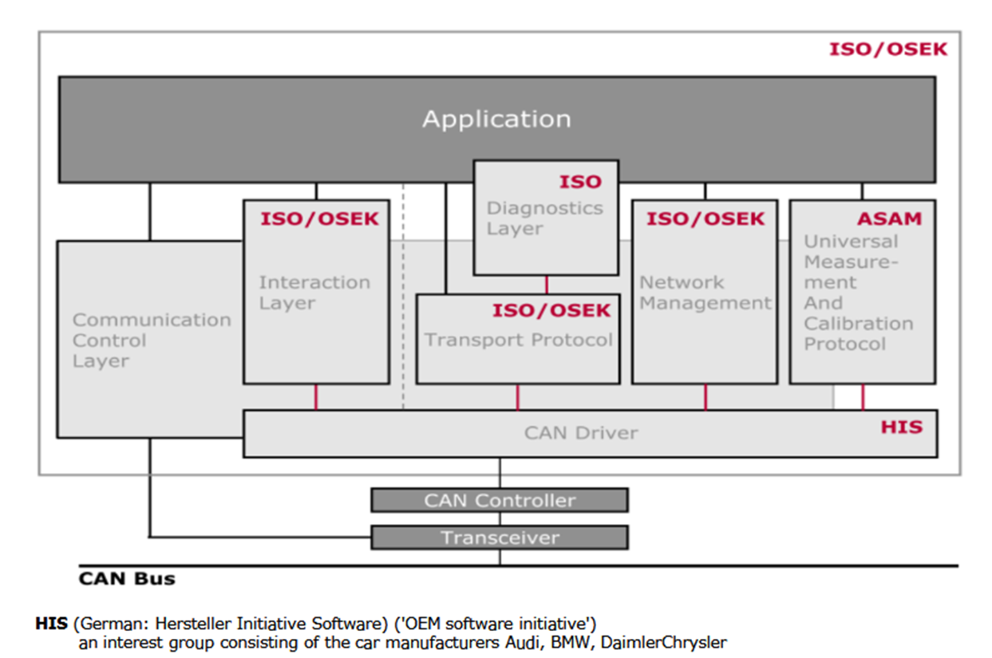
Before and After AUTOSAR
Before AUTOSAR software and hardware are depended so if any change happens in the hardware whole the things (application/software) need to change.
And these changes will require a lot of invested extra time to make the project functional again.
So, in AUTOSAR it is layer architecture so that only impacted layer will be the one that interacts directly with the microcontroller.

Slide 4
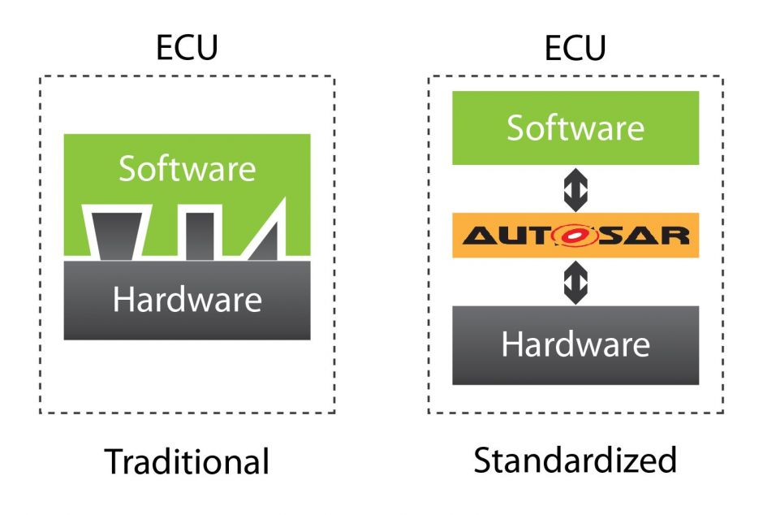
Using AUTOSAR, the software components are entirely independent of the hardware.
In other words, the application doesn’t need to know where the dependencies and inputs come from.
so, it can be reused in any other project multiple times, saving a lot of time and money. Without this standard, the software components must be re-developed by the underlying hardware every time.

Slide 5
Objective: AUTOSAR provides specifications of basic software modules, defines application interfaces and builds a common development methodology based on standardized exchange format. Basic software modules made available by the AUTOSAR layered software architecture can be used in vehicles of different manufacturers and electronic components of different suppliers, thereby reducing expenditures for research and development.
Modularity: customizing software regarding the specific requirements of each ECU and its tasks.
Scalability: avoiding software redundancy by adapting common modules to different vehicles platforms.
Transferability: optimizing the use of available resources within the electronic architecture of the vehicle.

Slide 6
Reusability: improving product quality and reliability.
Standardization: standardizing interfaces between different software layers across manufacturers and suppliers.
If a new software component needs to be added, using the standard, the focus will only be on implementing the inside algorithm, without adapting to the OEM environment.

Slide 7
AUTOSAR Architecture
AUTOSAR is an open system architecture for automotive software development and provides standards for developing common automotive software applications.
It is a growing and evolving standard that defines a layered architecture for the software.
The classic AUTOSAR platform runs on a microcontroller and is divided into 3 main layers.
Basic Software Architecture- It is common to any AUTOSAR ECU.
AUTOSAR Runtime Environment
Application Layer

Slide 8
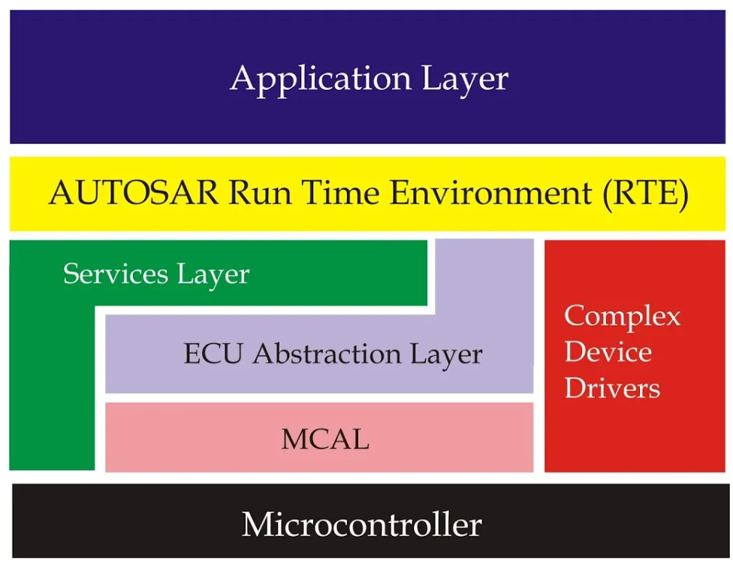
BSW
(Basic Software Layer)

Slide 9
Application Layer
The application layer is the first layer of the AUTOSAR software architecture and supports custom functionalities implementation. This layer consists of the specific software components and many applications which perform specific tasks as per instructions.
The AUTOSAR standard specifies the application layer implementation using a “component” concept.
The AUTOSAR application layer consists of three components which are:
Application software components
Ports of software components
Port interfaces.

Slide 10
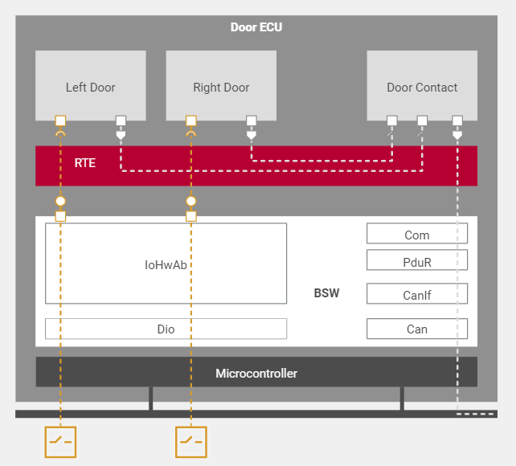
Application Software Component
The AUTOSAR application layer includes various application specific software components that are designed to execute specific set of tasks, as per the use case.
At the beginning , a system is only described by its functionality. Sub-functionalities are distributed to components. These components transfer information to other components utilizing defined interfaces.
Eg: Door control
Components:
Right Door
Left Door
Door Contact

Slide 11
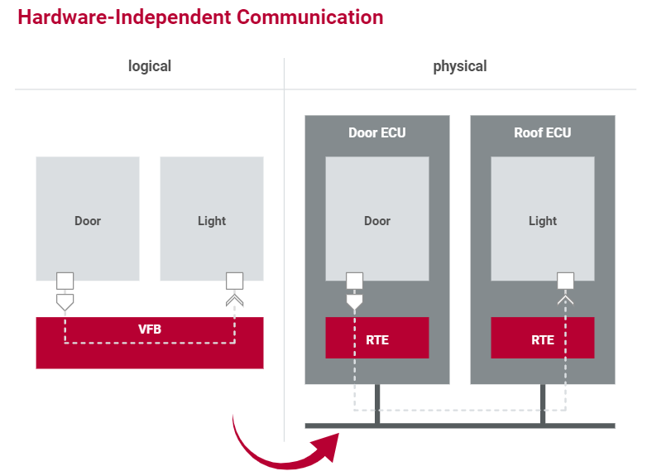
Hardware independent Communication
Virtual Function Bus (VFB):
VFB symbolizes the communication between the components.
The VFB represents the communication within an ECU as well as between ECU’s. The application has no knowledge of the underlying technologies.
The communication between software components is enabled via specific ports using a virtual Function Bus.
These ports also facilitate communication between software components and AUTOSAR Basic Software (BSW)

Slide 12
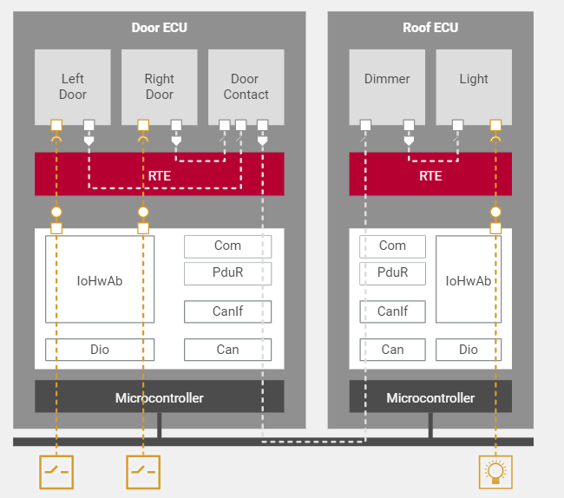
After all SWCs and interfaces have been set up and defined, they are distributed to the relevant ECUs.
Then the ECU-specific Runtime Environment implements the Virtual Functional Bus. The RTE organizes communication between the individual software components and – with the help of the operating system – handles execution of the software components.

Slide 13
Types of Software Components:
Atomic Component
It cannot be further subdivided, This will mainly contain the implementation of the component algorithm.
The AUTOSAR software component(SWC) is an atomic software code fragment and part of the application. SWCs are independent of the infrastructure and can be mapped to any ECU.
The Sensor/Actuator software components are a special type of atomic components and represent dependency on a special sensor/Actuator.
Composition
Logical organization or encapsulation of SWCs and/or composition
A composite component offers a logical interconnection of other components, which could be either atomic or composite

Slide 14
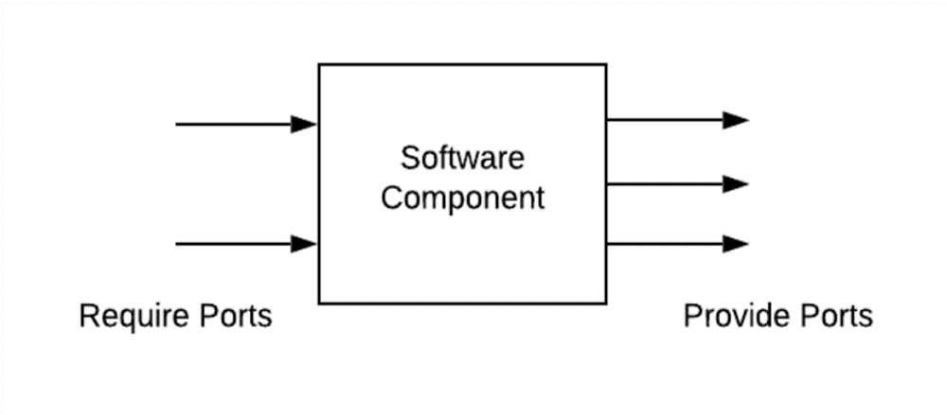
Types of Ports:
Software components have ports
The AUTOSAR Software Components use well-defined ports, which encapsulate certain interfaces as a guarantee for type safety while components are communicating with each other.
A port is mapped to a single component and represents a communication point between the components.
Require Port (R-Ports)
Provide Ports (P-Ports)

Slide 15
Port Interfaces:
Interface to other components for communication
Sender Receiver Port Interface
Client Server Port Interface
Parameter Port Interface
Mode Switch Port Interface
Nv-Data Port Interface
Sender Receiver Communication:
It is used for the asynchronous data transmission. A sender provides data to one or more receivers asynchronously. The Sender neither expects nor receive any data
Contents: Data Elements
Communication: 1:n or n:1

Slide 16
Client Server:
An alternative method for communication between SWCs. The server offers services which are requested by the client.
Contents: Operations
Communication: 1:1 or n:1 (Multiple client to single server)

Slide 17
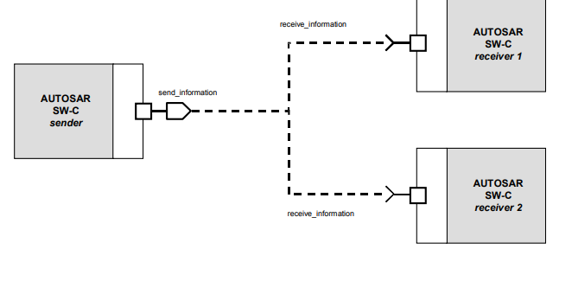
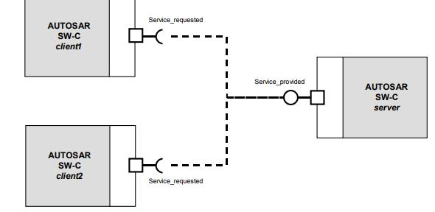
Sender – Receiver Port
Client – Server Port

Slide 18
Runnable:
Atomic software components contain runnable entities ( Runnable )
It is the function containing the actual implementation and executable unit of a software component
Void Runnable(void)
Software components contains one or more runnable entities (“runnable”)
This function is called by the RTE if the corresponding trigger occurs

Slide 19
RTE (Run Time Environment)
AUTOSAR Run-time Environment is a middleware layer of the AUTOSAR software architecture between the BSW and the application layer and provides communication services for the application software.
The AUTOSAR Software Components communicate with other components (inter and/or intra ECU) and/or services via the RTE.
Task
Make AUTOSAR Software Components independent from the mapping to a specific ECU.
Properties Implementation:
ECU and application specific (generated individually for each ECU)
Upper Interface: completely ECU independent

Slide 20
Functionality:
Middleware providing communication services(Inter/Intra)
The RTE as middleware integrates individual applications with the basic software.
It organizes the communication and data exchange between the two and handles execution of software functions(runnable).
RTE is configured (mapping runnable to OS tasks)
Trigger runnable via RTE events
Configures parts of the OS(tasks, Events, alarms)
Implements communication between components
RTE is different for each ECU and customized to requirement of SWC
RTE prevents SWC from directly accessing OS and BSW
RTE does not have any run time components

Slide 21
The BSW Layer (Basic Software Layer)
An AUTOSAR system is described in the form of Software Components, which are interconnected via the VFB (or ECU-specific RTEs). This abstraction might suggest that AUTOSAR Basic Software only covers communication. This is not the case.
AUTOSAR Basic Software also provides internal ECU services such as state management (ECU state and control of the communication channels), diagnostic services, watchdog services, operating system and management of the nonvolatile memory; even IO is covered within AUTOSAR standardization.
Standardized Basic Software Component:
Services
Communication
Operating System
Microcontroller Abstraction

Slide 22
ECU Specific basic software component:
ECU Abstraction
Complex device drive
BSW Layer subdivided into following Layer:
Service Layer
ECU Abstraction Layer
MCAL Layer (Microcontroller Abstraction Layer)
CDD (Complex Device Driver)

Slide 23
1. Service Layer:
The service layer provides different types of background services, memory management and bus communication services. The OS also contained in this layer.
2. ECU Abstraction Layer:
The ECU Abstraction layer offers uniform access to all of an ECU’s functionalities such as communication ,Memory, IO regardless of whether the functionalities are in-chip or On-Board.
3. MCAL Layer:
The Micro Controller Abstraction Layer contains hardware specific drivers for access to memory , communication and IO of the microcontroller
4. CDD:
The Complex Device Drivers contain the drivers for the specific properties of micro controller or ECU which are not standardized in the AUTOSAR.

Slide 24
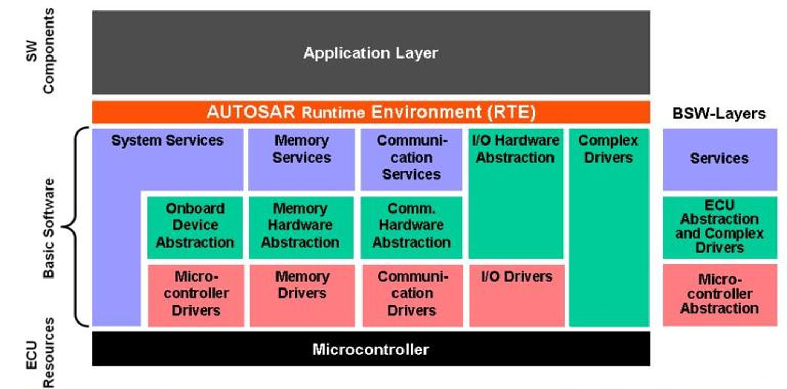

Slide 25
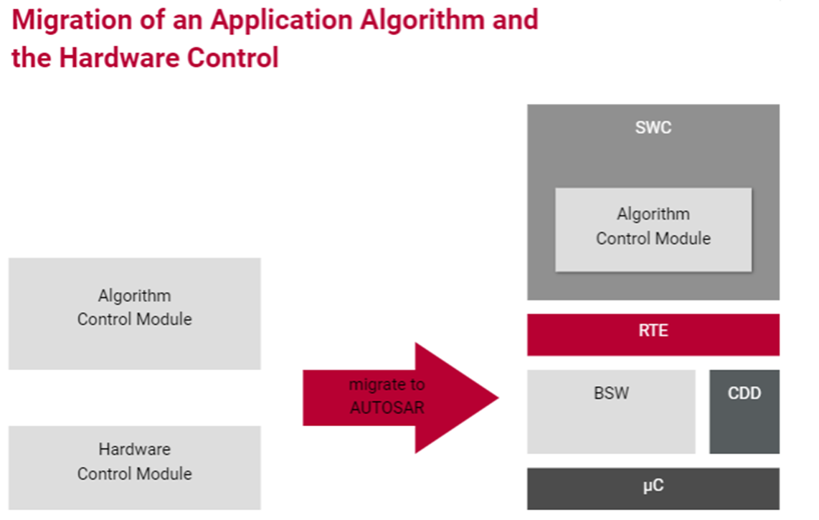

Slide 26
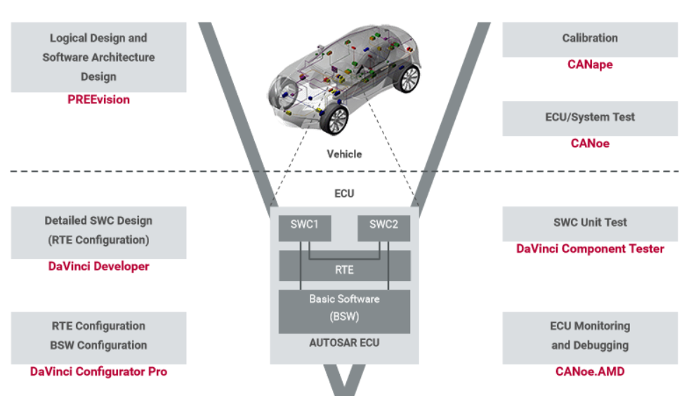

Slide 27
Smarter. Greener. Together.
To learn more about Delta, please visit
www.deltaelectronicsindia.com

